Slide 1

GOKARAJU RANGARAJU INSTITUTE OF ENGINEERING AND TECHNOLOGY
Department of Computer Science and Engineering
Major Project
F-8 Batch

Slide 2
“Drone Detection, Localization and Classification using YOLO”
Name of the Student | H.T.Number
Valaboju Ruchita | 19241A05Z4
Vaishnavi | 19241A05Z3
Chitiprolu Harshitha | 19241A05U8
Kallam Alekhya Reddy | 19241A05V8
Under the Guidance of
Dr. B. Sankara Babu
Professor
Dept. of CSE

Slide 3
Presentation Outlines
Abstract
Proposed System
Methodologies
Implementation
Conclusions and Future Work

Slide 4
Abstract
Drones, also known as Unmanned Aerial Vehicles (UAVs) are used in tasks including rescue operations and item delivery in remote areas, surveillance, agriculture, wildlife conservation, outer space and photography. Due to their low cost and high efficiency, they are being used by different groups for both better and worse causes, although the good ones outweigh the bad ones. Recent drone attacks leading to compromised civilian safety and privacy have caused a shift in how we perceive the usage of drones.
In order deal with the malicious activity of drones and keep track of them in the given Region of Interest (RoI), we propose the implementation of You Only Look Once (YOLO), an Image Processing algorithm for the detection and localization of drones in real time. We also provide the classification of drones into the following categories: Army, Delivery and Surveillance drones with a certain confidence level.

Slide 5
1. Proposed System
In order to deal with the malicious activity of drones, we propose a system based on YOLO V5 algorithm, that is capable of detecting the drone in the Region of Interest (RoI), give the relative location with respect to the camera. The YOLO family of algorithms is particularly fast and accurate for real-time object detection applications.
We deployed the custom object detection approach that involves directly classifying the drone at the time of localization itself, into one of these categories: Army Drone, Delivery Drone and Surveillance Drone.

Slide 6
2. Methodologies
2.1. Object Detection and Localization
The term detection defines the possibility of the required object being present in the given image whereas localization refers to derive the coordinates of the object’s location in the image.
2.2. You Only Look Once (YOLO)
It is a deep neural network that works on the principle of dividing the image into various grids before hand and scans the image only once while training. It is used for both object detection and localization and is popular due to its high speed in training and detection because of the above mentioned principle.

Slide 7
2.3. Custom Object Localisation
The YOLO algorithm provides pre-trained weights for some common objects as mentioned in COCO list. But when we are interested in an object that is not very common, we need to prepare a dataset and corresponding weights on our own for our custom object detection and localisation.
2.4. WandB (Weights and Biases)
It is a predefined module that regulates and stores the results such as weights and metrics that are performed in different experiments of a project.
.

Slide 8
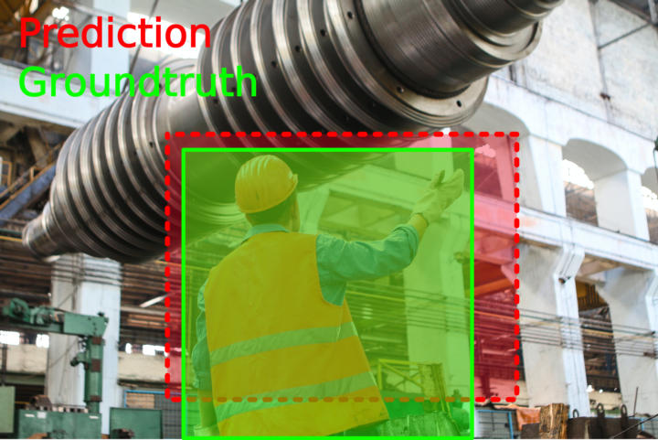
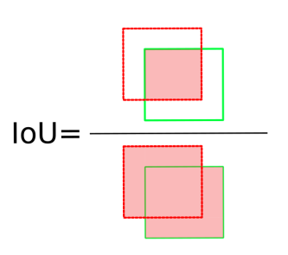
2.5. Intersection over Union (IoU)
It is defined as the area of the two bounding boxes’ union divided by the union of the area of the two bounding boxes.

Slide 9
2.6. Confidence
It is defined as the product of the probability of containing the required category of object and its Intersection Over Union.
It is given by P(obj_cat1)*IoU(obj).
2.7. Precision and Recall for Localisation
We choose a threshold of IoU as α. If we have the image IoU a>=α, then it is said to be a True Positive (TP).

Slide 10
True Negative if a=0 and there is no ground truth box.
False Positive if a<α
False Negative if a<α || a=0 and when there is ground truth box.
2.8. Mean Average Precision
It involves calculating the area under the Precision-Recall curve for each class label and taking an average of them.

Slide 11
3. Implementation
3.1. Obtaining and Preprocessing the dataset
An image dataset consisting of 300 Army, 300 Delivery and 300 Surveillance Drone images have been collected.
Size of Train Set: 900 and Validation Set : 90.
We have three categories : Army, Delivery and Surveillance drones.
Army Drone: MQ-1C Gray Eagle, RQ-4 Global Hawk, MQ-4C Triton , MQ-9 Reaper.
Surveillance: Most images consist of quadcopter drones.
Delivery Drone: Most images consist of box carrying drones.
For n=900 given images and m=3 given categories

Slide 12
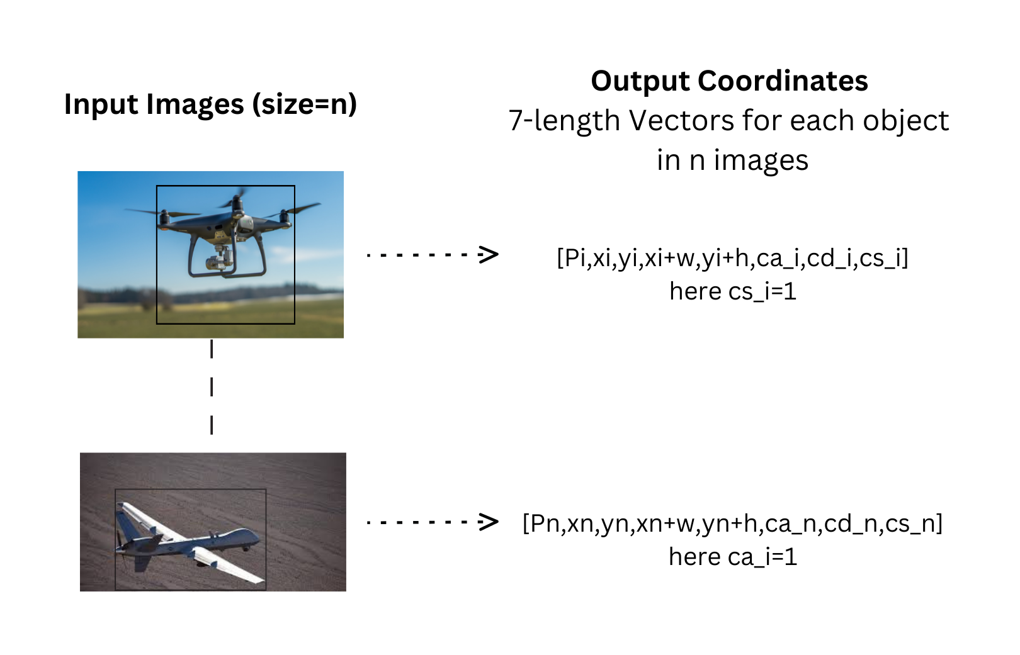
.

Slide 13
For a given image i: (x,y) --> Top Left Coordinates of the object bounding box (w,h)--> Width and Height of a bounding box ca = 1 --> when the object belongs to army drone cd = 1 and cs = 1 correspond to delivery and surveillance drones respectively Pi--> Probability that an object belongs to the class given by ca, cd or cs

Slide 14
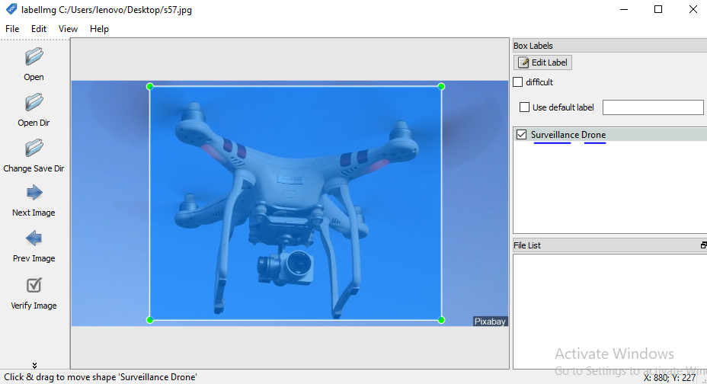

Slide 15
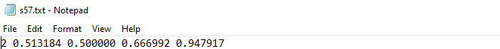
-- Classes are represented as integers in the text file. 0 represents Army drone. 1 represents Delivery drone. 2 represents Surveillance drone.
-- The coordinates give the top-left most and bottom right most coordinates of the bounding box, namely (x+w, y+h, x, y) where w and h are the width and the height of the box. All the images are zipped and stored aside.

Slide 16
3.2. Training and Prediction
The training of the images is done using the YOLO V5 framework.
The framework is responsible for training and validation of the image class and bounding box predictions.
There is a predefined Convolutional Neural Network which is to be used to train the images and labels to implement the YOLO mechanism.

Slide 17
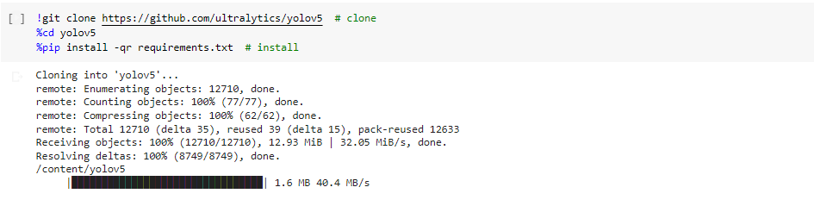
Importing the required framework by cloning the GitHub repo of YOLO V5.
We add the repository to the drive.

Slide 18
Importing other required modules
Extracting the Drone_Images folder
Changing the directory to Yolo V5 framework

Slide 19
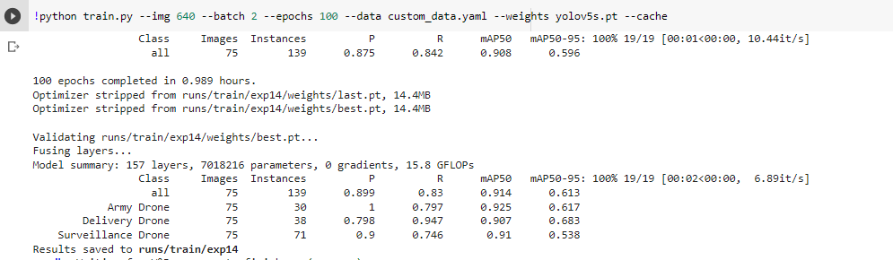
Training the images by running the following command
In short:
train.py → Consists of the selected model architecture YOLO V5S and saves the weights for each training epoch.
Custom_data.yaml → Consists of the path of the train and validation sets of images and their corresponding labels.
yolov5s.pt → Consists of the weights and biases corresponding to the YOLO V5S architecture.

Slide 20
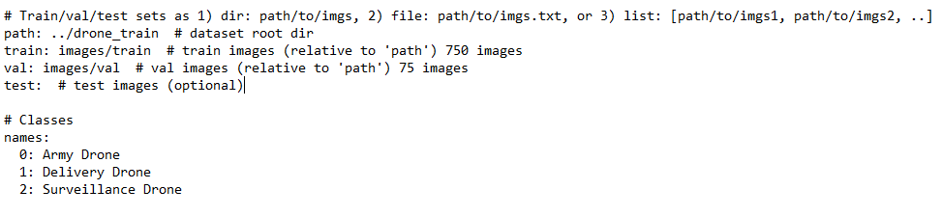
Custom_data.yaml

Slide 21
train.py downloads the connections of the YOLO V5s architecture that is selected and accesses the paths of train and validation folders using custom_data.yaml file.
During each epoch of training, the validation set metrics and weights are written into the /content/drive/MyDrive/yolov5/runs/train directory. It involves hyperparameter tuning and early stopping in order to give the weights of a well-fit model.
By accessing this directory we can make use of the last epoch’s or best epoch’s weights to make new predictions.
yolov5s.pt consists of the weights corresponding to the YOLO V5S CNN architecture.

Slide 22
train.py makes an API call to the weights and biases website through wandb, a predefined Python module.
This call checks the authentication of a registered user and creates a project for the particular project on the Website Weights and Biases.
The project consists of the weights corresponding to each run of the training command.
It showcases all the metrics like Precision, Recall, F1-Score and Mean Average Precision corresponding to each training trial through graphs.
It also helps in saving the weights files locally in the yolov5 folder.

Slide 23
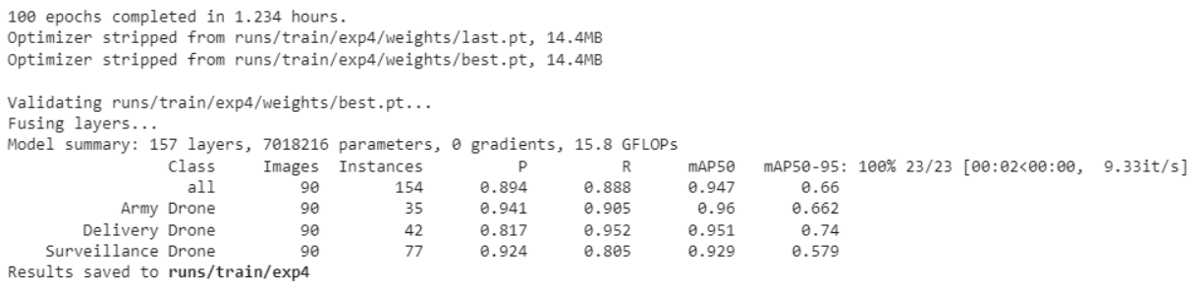
The trained model weights and the metrics are saved as shown in the last line of the code. The metrics of the model are as follows:

Slide 24
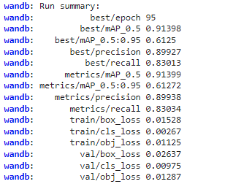
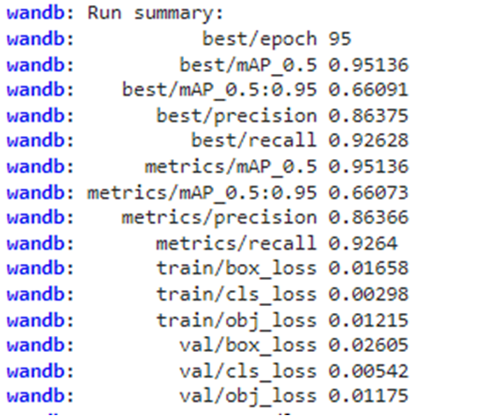
Overall results for all the categories include:
For N=750 For N=900

Slide 25
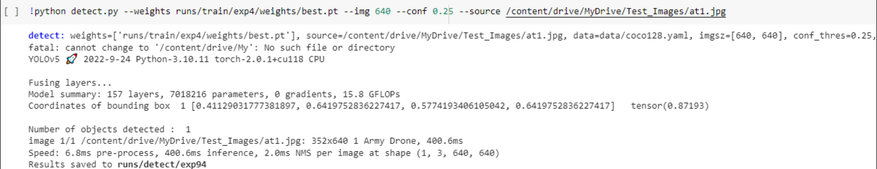
Code for detection of objects in the new image:

Slide 26
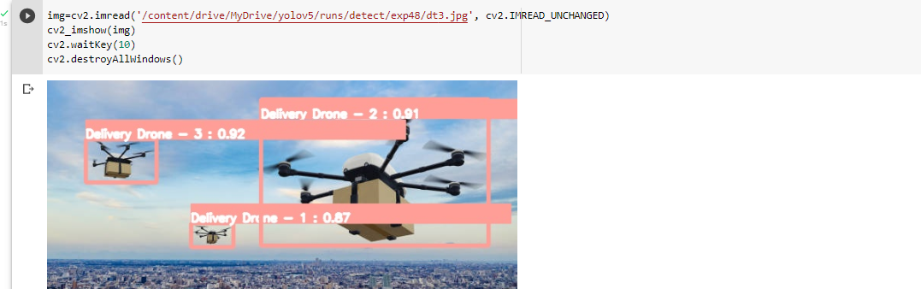

Slide 27
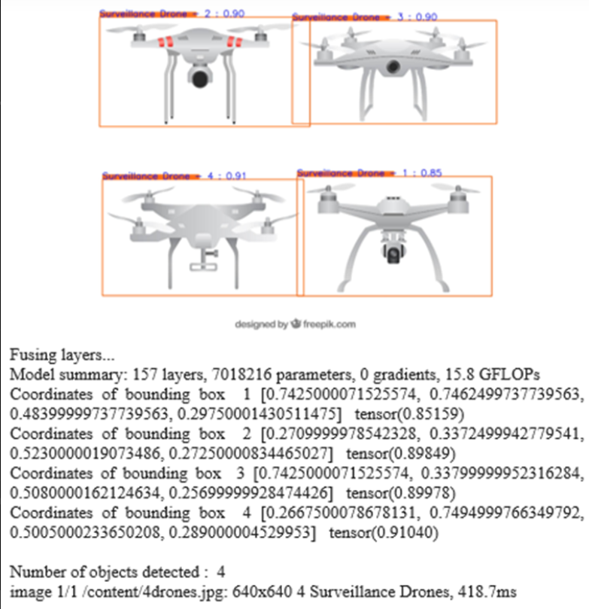

Slide 28
3.2.1. Comparison of Model_750 and Model_900
Number of Images (N) | Metric
 | Accuracy | Precision | Recall | F1-Score | mAP50 | mAP50-95
N=750 | 0.641 | 0.868 | 0.865 | 0.866 | 0.913 | 0.617
N=900 | 0.680 | 0.889 | 0.904 | 0.896 | 0.95 | 0.665

Slide 29
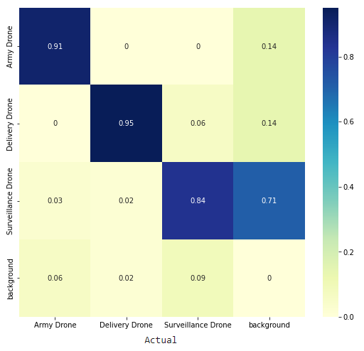
3.2.2. Confusion Matrix

Slide 30
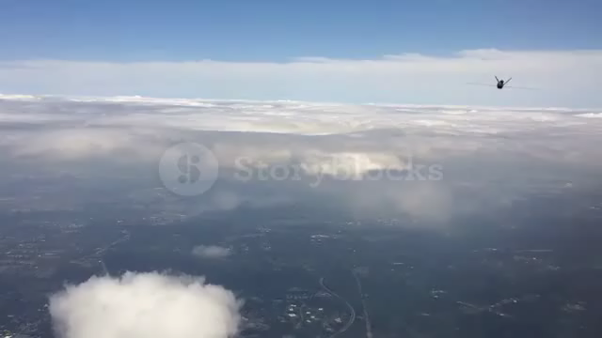
3.2.3 Video Results

Slide 31


Slide 32
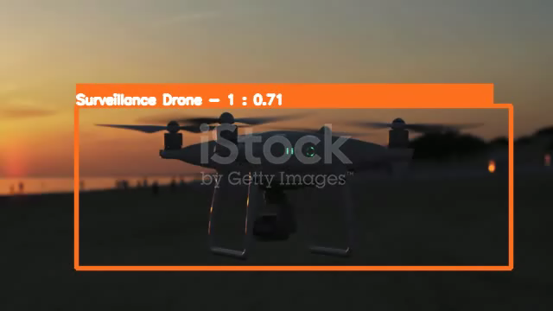

Slide 33
4. Conclusions and Future Work
The newly predicted images are automatically stored and can be used for re-training in the future for better performance. The difficulty in re-training lies in the preprocessing which involves manual-labeling of large number of images. Storage of the predicted images and videos for future use will require large databases and they might require constant scaling-up. If one opts to use public cloud, security cannot be ensured which is important for this application. Improving the performance of the model by eliminating the risk of mis-identifying birds as surveillance drones and airplanes as army drones. Incorporating more varieties of military drones into the army dataset and evolving the model to classify specific kinds of army drones as separate classes.

Slide 34
THANK YOU

